Slide 1
Yelp Dataset - Analysis
Adri Mukherjee
adri.mukherjee1@gmail.com
“Please do not hesitate to reach out if you have questions or want to chat about other approaches to this Yelp Analysis”

Slide 2
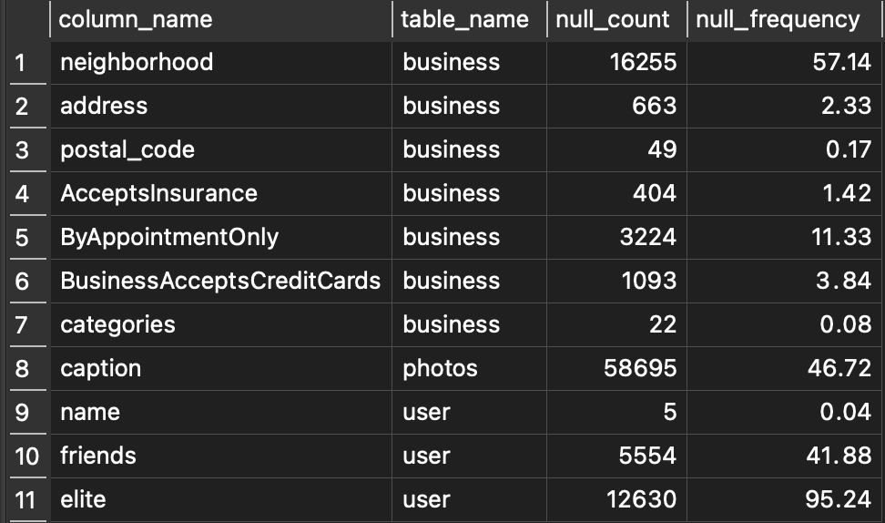
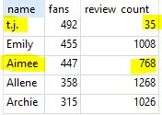
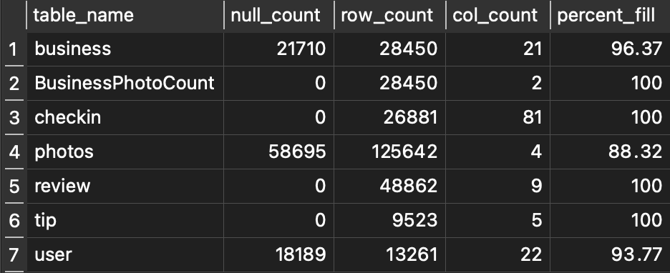
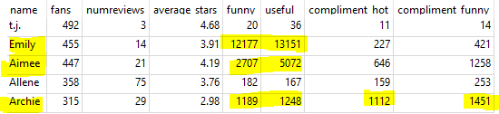
Database Completeness
Reviewers Analysis
Q1
Users: 4/10 without friends, few are elite
Businesses: unknown neighborhoods, uncaptioned photos
How many reviewers are there? 48,862 reviewers
How are the reviews changes over time? 11,036 reviews given in 2017 vs. 40 reviews given in 2006
How many are elite members? 631 users are elite
How long have the elite users been membered since? Average of 5.88 years
Does number of reviews correlate with number of fans?
Possibly. But user T.J and Aimee below have highest fan base but their review counts are not the highest.
What other attributes positively correlate with fan base?
Pulling other factors, user Emily, Aimee, and Archie shows that there is a positive correlation between comments interactions and fan base. User t.j. Might be an outlier.
(Table below)
Incomplete Rows
Completeness of Tables

Slide 3
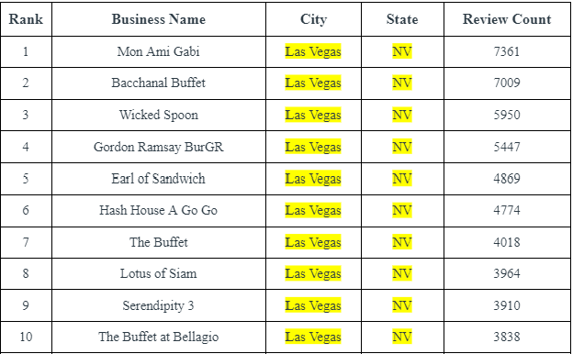
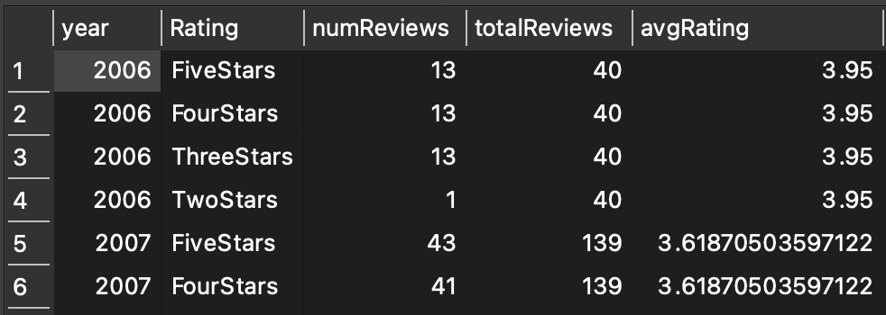
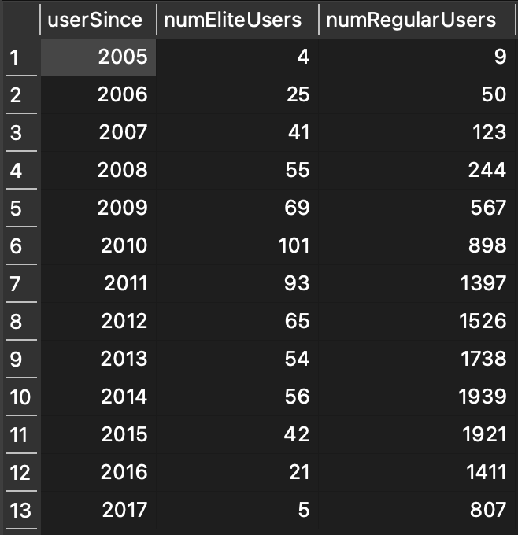
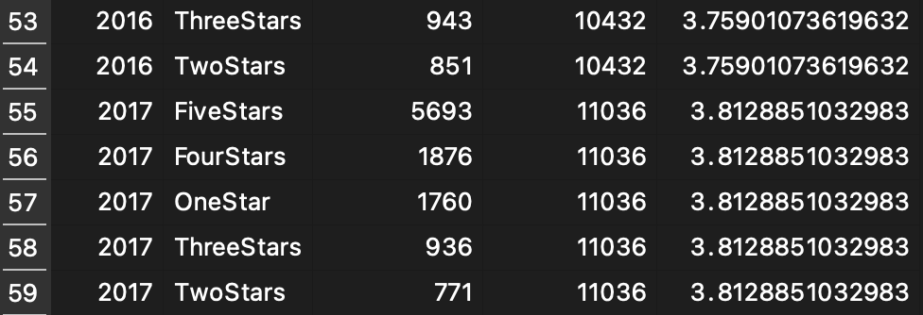
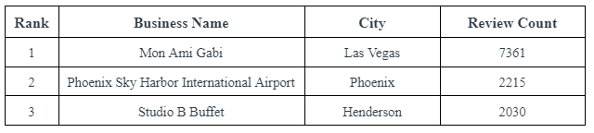
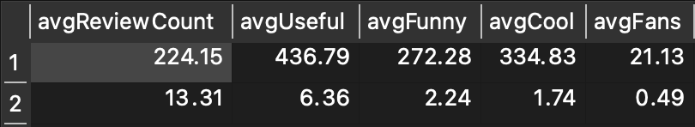
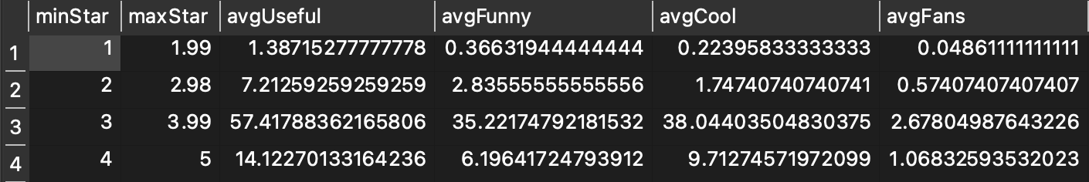
Business Analysis
Trends Within Yelp Data
Q1
Top 10 business with highest review_count are all in Las Vegas
Number of users joined per year from 2005 to 2017 separated into whether they are elite or regular users. Both follow the same trend as number of users increase from 2005 to 2014 and decrease from 2015 and on
Shows the amount of reviews given per year from 2006 to 2017 grouped by rating (1/2/3/4/5 stars), the number of reviews for each rating and the average rating for that year. The amount of reviews increased significantly, with only 40 reviews given in 2006 to total of 11,036 given in 2017. In all years except 2006,2008 and 2009, the number of 5 star ratings given was higher than all other ratings
Top 3 Cities based on Review Count : Las Vegas, Phoenix, Henderson
This table shows the average number of Useful, Funny, Cool and Fans based on if the user is elite or not. The first row is for elite users and the second row is the averages for non-elite users. On average, elite users have written more reviews, and their reviews get higher Useful, Funny, Cool and Fan ratings than non-elite users.
Mon Ami Gabi
Phoenix Sky Harbor International Airport
Studio B Buffet
23,507 businesses in dataset
5318 total businesses in Las Vegas
This table shows the average number of Useful, Funny, Cool and Fans based on the average amount of Stars the user has given. The first row are the averages for Useful, Funny, Cool and Fans for users who give out an average of 1 to 1.99 stars. The reviews that are most useful, funny, cool with the highest amount of fans are from users who leave an average of 3 to 3.99 stars.

Slide 4

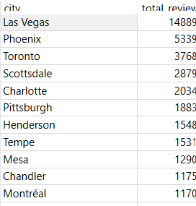
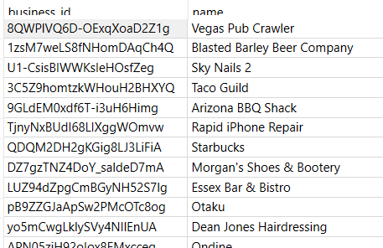

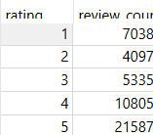
Reviews Analysis
Q1
Restaurant With Least Number of Reviews
Number of Reviews Per City
5 Star Businesses
Number of 1 Star, 2 Star, 3 Star, 4 Star, 5 Star Reviews

Slide 5

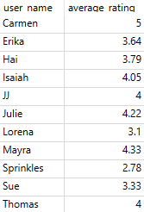
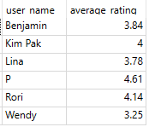
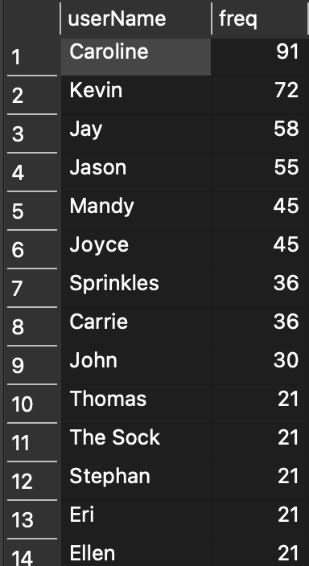
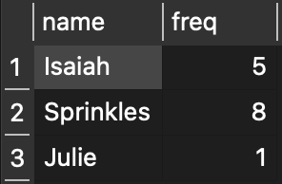
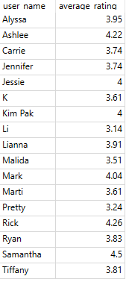
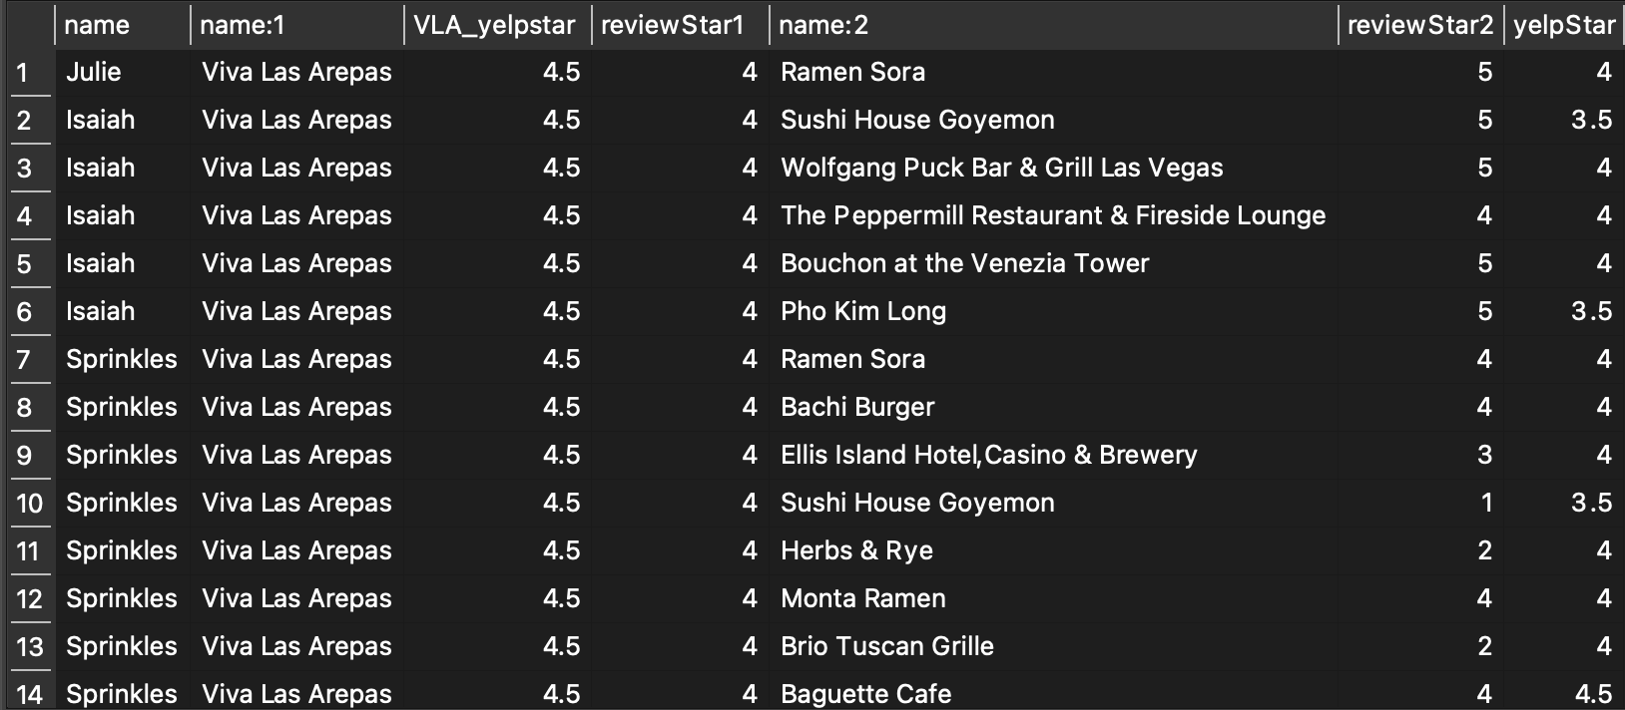
Note: Code utilized in this reduced dataset should also translate to the actual Yelp dataset
Q2
Prompt
3 of the highest rated restaurants
Deepdive into the trends of high and low rated restaurants in order to perform comparative analysis on the businesses within the Yelp dataset, I decided to come up with 4 criterias so we are comparing similar businesses:
Business is categorized as a restaurant
Business is located in Las Vegas
Business has reviews that range for 5 years or greater
Business has over 1000 reviews
Total average rating of individual reviewers (based on all their reviews across different places)
Viva Las Arepas
Raku
Oyster Bar
3 users listed above made reviews on Yelp for the restaurant Viva Las Arepas as well as other restaurants on the list. For example, Isaiah reviewed Viva Las Arepas as well as 5 other restaurants on the list
253 users have reviewed more than one business in our identified list. Of those 253 users, Caroline has the most number of reviews, with 91 reviews left for the businesses on the list.
The average stars for the top 3 rated restaurants come out to 4.5. However, an interesting trend across users who left reviews is that their average stars they give out is generally lower.
Viva Las Arepas - 1 user who averages rating > 4.5
Raku - 1 user who averages rating > 4.5
Oyster Bar - 1 user who averages rating = 4.5
This table lists what each user rated Viva Las Arepas, average yelp rating of Viva Las Arepas, the other restaurants in the list that user reviewed, their review of that restaurant and the average yelp review. From this table, you can infer user Sprinkles usually gives less stars than what the restaurant receives on average, while Isaiah tends to give more stars than what the restaurant receives on average. This kind of trend analysis is valuable to see since users also have biases that tend to give businesses higher or lower ratings based on what type of user they are.
Based on the above analysis, it can be inferred that reviewers who leave a review can be more critical toward restaurants

Slide 6
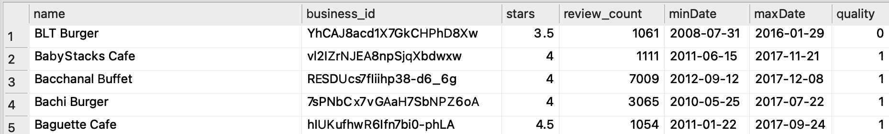


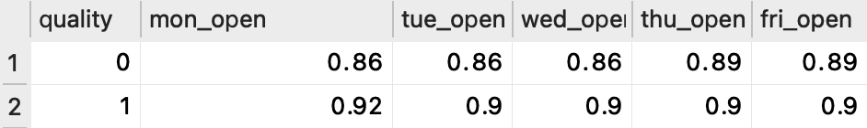
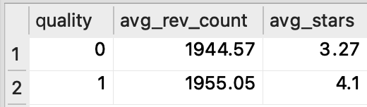
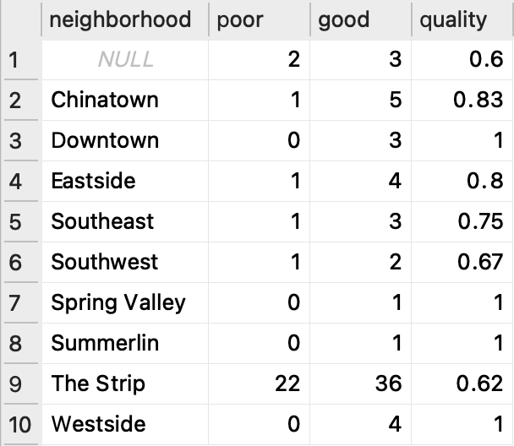
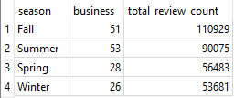
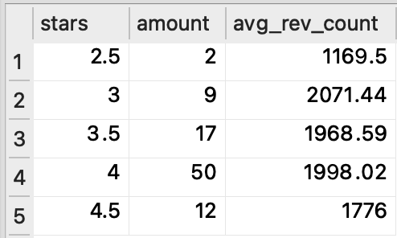
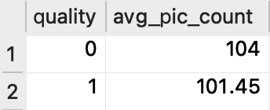
Note: Code utilized in this reduced dataset should also translate to the actual Yelp dataset
Q2
Reviews Analysis
“Good” VS “Bad” Restaurants
What are the earliest and recent dates that a restaurant in Las Vegas receive their review on?
Restaurants < 4 stars as bad “quality”
Percentage open on a given day
Review counts for restaurants in Las Vegas shows that reviews activity happened mainly during Fall, Summer, Spring, then Winter respectively. We can raise a hypothesis that Fall and Summer are the busiest seasons for reviewers, inevitably for business operations as well, which led to another question of whether Las Vegas experiences higher traffic of travelers in Fall and Summer?
Average stars per “quality”
Restaurant quality by neighborhood
Stars distribution
Pictures by quality

